Slide 1
IT304 Computer Networks
Week6_Lec1_P2P-I

Slide 2
Topics for today
What is a Peer to peer Network?
How is it different from Client-Server architecture?
Why P2P?
Example applications of P2P?
BitTorrent – How does it work?
Distributed Hash Table – An Overview

Slide 3
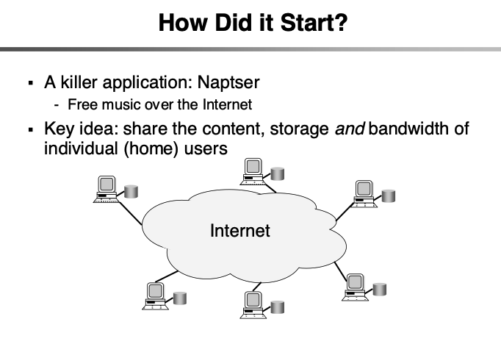

Slide 4
















Peer-to-peer (P2P) architecture
no always-on server
end systems (PEERS) directly communicate
peers request service from other peers,
provide service in return to other peers
self scalability – new peers bring new service capacity, and new service demands
peers are intermittently connected and change IP addresses
complex management
examples: P2P file sharing (BitTorrent), streaming (KanKan), VoIP (Skype)
mobile network
national or global ISP
local or regional ISP
home network
content
provider
network
datacenter
network
enterprise
network

Slide 5
Why P2P over Client Server?

Slide 6

File distribution: client-server vs P2P
Q: how much time to distribute file (size F) from one server to N peers?
peer upload/download capacity is limited resource
u_{s}: server upload capacity
d_{i}: peer i download capacity
file, size F
u₁
d₁
u₂
u_{s}
d₂
server
d_{i}
u_{N}
network (with abundant
bandwidth)
u_{i}
d_{N}
u_{i}: peer i upload capacity

Slide 7
Client-server vs. P2P: example
client upload rate = u, F/u = 1 hour, u_{s} = 10u, d_{min} ≥ u_{s}

Slide 8
File distribution time: client-server
server transmission: must sequentially send (upload) N file copies:
time to send one copy: F/u_{s}
time to send N copies: NF/u_{s}
F
u_{s}
d_{i}
network
client: each client must download file copy
d_{min} = min client download rate
min client download time: F/d_{min}
u_{i}
time to distribute F
to N clients using
client-server approach
D_{c-s} > max{NF/u_{s,},F/d_{min}}
increases linearly in N

Slide 9
File distribution time: P2P
server transmission: must upload at least one copy:
time to send one copy: F/u_{s}
F
u_{s}
client: each client must download file copy
min client download time: F/d_{min}
d_{i}
network
u_{i}
clients: as aggregate must download NF bits
max upload rate is u_{s} + Σu_{i}
time to distribute F
to N clients using
P2P approach
D_{P2P} > max{F/u_{s,},F/d_{min,},NF/(u_{s} + Σu_{i})}
increases linearly in N …
… but so does this, as each peer brings service capacity

Slide 10


P2P file distribution: BitTorrent
file divided into 256KB chunks
peers in torrent send/receive file chunks
tracker: tracks peers
participating in torrent
torrent: group of peers exchanging chunks of a file
User arrives …
… obtains list
of peers from tracker
… and begins exchanging
file chunks with peers in torrent

Slide 11


P2P file distribution: BitTorrent
peer joining torrent:
has no chunks, but will accumulate them over time from other peers
registers with tracker to get list of peers, connects to subset of peers (“neighbors”)
while downloading, peer uploads chunks to other peers
peer may change peers with whom it exchanges chunks
churn: peers may come and go
once peer has entire file, it may (selfishly) leave or (altruistically) remain in torrent

Slide 12
BitTorrent: requesting, sending file chunks
Requesting chunks:
at any given time, different peers have different subsets of file chunks
periodically, Alice asks each peer for list of chunks that they have
Alice requests missing chunks from peers
rarest first
Sending chunks: tit-for-tat
Alice sends chunks to those four peers currently sending her chunks at highest rate
other peers are choked by Alice (do not receive chunks from her)
re-evaluate top 4 every10 secs
every 30 secs: randomly select another peer, starts sending chunks
“optimistically unchoke” this peer
newly chosen peer may join top 4

Slide 13

BitTorrent: tit-for-tat
(1) Alice “optimistically unchokes” Bob
(2) Alice becomes one of Bob’s top-four providers; Bob reciprocates
(3) Bob becomes one of Alice’s top-four providers
higher upload rate: find better trading partners, get file faster !

